Slide 1



Embedding with eDFTpy
Team Embedding
Department of Chemistry & Department of Physics
Rutgers, the State University of New Jersey, Newark, NJ
Wednesday October 13th 2021

Slide 2

Install eDFTpy
Requirements
Python 3.6 or newer
NumPy 1.18 or newer
SciPy 0.18 or newer
DFTpy latest
ASE 3.21.1 or newer
pylibxc
mpi4py 3.0.2 or newer
mpi4py-fft 2.0.4 or newer
xmltodict
upf_to_json
Install
You can get the source from gitlab like this:
$ git clone https://gitlab.com/pavanello-research-group/edftpy.git
$ python -m pip install ./edftpy
or simpler:
$ python -m pip install git+https://gitlab.com/pavanello-research-group/edftpy.git
http://dftpy.rutgers.edu/
http://edftpy.rutgers.edu/

Slide 3

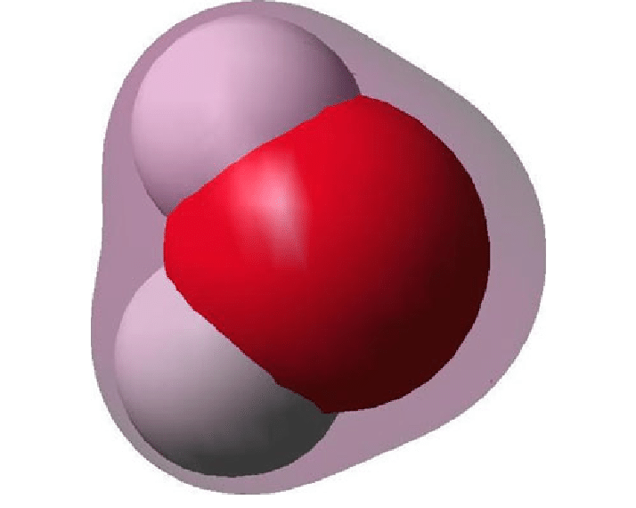
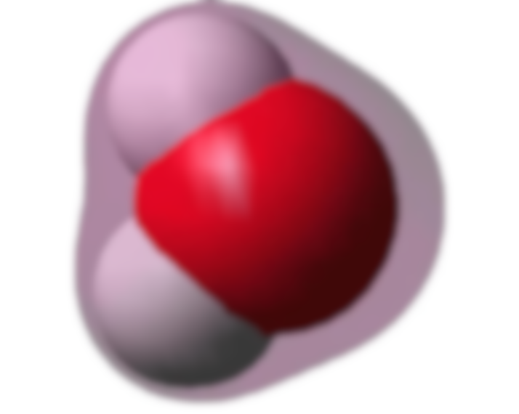
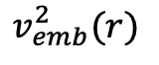
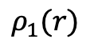
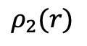
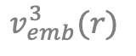
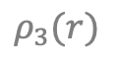
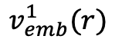
What does eDFTpy do? And why is it called eDFTpy?
$$ρ_{1}(r)$$
$$v_{emb}^{1}(r)$$
QEpy
QEpy
QEpy
QEpy
$$ρ_{3}(r)$$
QEpy
$$v_{emb}^{3}(r)$$
$$ρ_{3}(r)$$
QEpy
$$v_{emb}^{3}(r)$$
$$ρ_{3}(r)$$
$$v_{emb}^{3}(r)$$
$$ρ_{2}(r)$$
$$v_{emb}^{2}(r)$$
$$ρ_{3}(r)$$
$$v_{emb}^{3}(r)$$
$$ρ_{3}(r)$$
$$v_{emb}^{3}(r)$$
$$ρ_{3}(r)$$
$$v_{emb}^{3}(r)$$

Slide 4
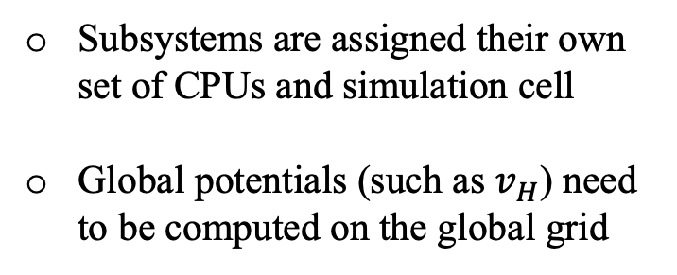
eDFTpy must handle parallel lead balancing
CPU
CPU
Compute node
CPU
CPU
CPU
CPU
Compute node
Subsystems are assigned their own set of CPUs and simulation cell
Global potentials (such as $v_{H}$) need to be computed on the global grid
CPU
CPU
CPU
CPU
Compute node
CPU
CPU
CPU
CPU
Compute node
CPU
CPU

Slide 5
Simulation cells and FFT grids in eDFTpy
Large simulation cell (physical)
Subsystem cells (not physical)
eDFTpy handles maps between them

Slide 6
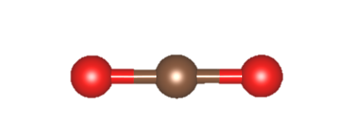
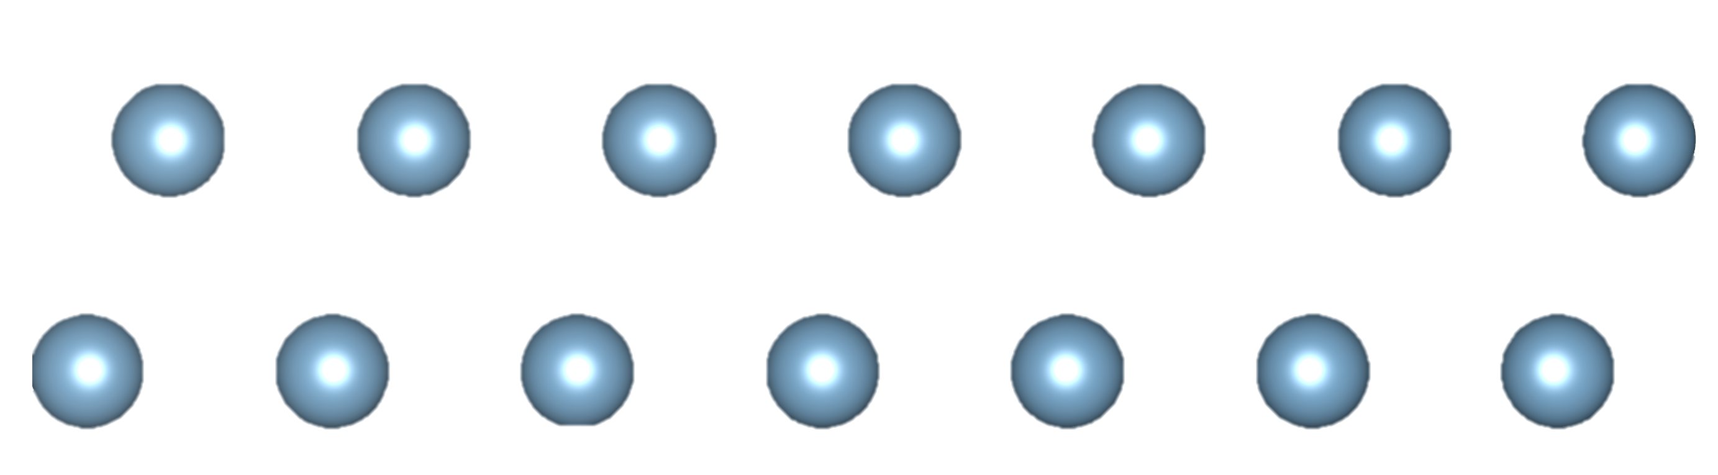
Parallel communication: brain fry
Work
Data
1
2
A system composed of 4 subsystems
Work and data are handled differently
3
4

Slide 7
Parallel communication: brain fry²
comm_region
Global
Region
comm_region
comm_world
comm_sub
Subsystem
4
comm_sub

Slide 8
Flowchart of eDFTpy
Initialize global grid
DFTpy
QE
Environ
build subsystem and initialize subsystem driver
Evaluate the embedding potential
Diagonalization:
OF-DFT and KS-DFT
Direct energy minimization:
OF-DFT
Get the new density
NO
Update the density
Density mixing for subsystem
Summed to yield the global density
Convergence?
YES
END

Slide 9
Let’s try eDFTpy with a simple input file run!
[JOB]
task = Optdensity
[PATH]
pp = ./
cell = ./
[PP]
O = O_ONCV_PBE-1.2.upf
H = H_ONCV_PBE-1.2.upf
[OPT]
maxiter = 200
econv = 1e-6
[GSYSTEM]
cell-file = h2o_2.xyz
grid-ecut = 1200
exc-x_str = gga_x_pbe
exc-c_str = gga_c_pbe
kedf-kedf = GGA
kedf-k_str = revAPBEK
density-output = total.xsf
[SUB_KS_0]
calculator = qe
embed = KE
cell-split = 0.5 0.5 0.5
cell-index = 0:3
grid-ecut = 2400
density-output = .xsf
;basefile = qe_in.in
[SUB_KS_1]
calculator = qe
embed = KE XC
cell-split = 0.5 0.5 0.5
cell-index = 3:6
grid-ecut = 2400
input.ini
[SUB_KS]
calculator = qe
embed = KE XC
cell-split = 0.5 0.5 0.5
cell-index = 0:6
decompose-method = distance
decompose-radius-O = 0.90
decompose-radius-H = 0.60
grid-ecut = 2400
./Materials/examples-scf
input_auto.ini
Notes:
section

Slide 10
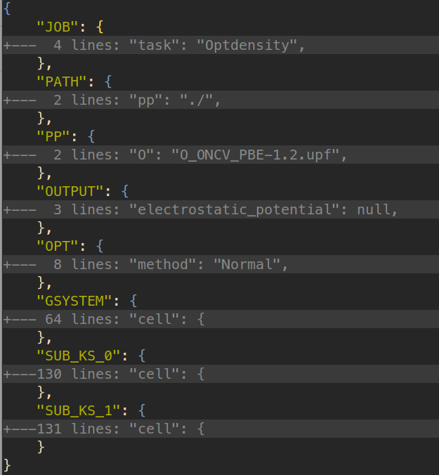
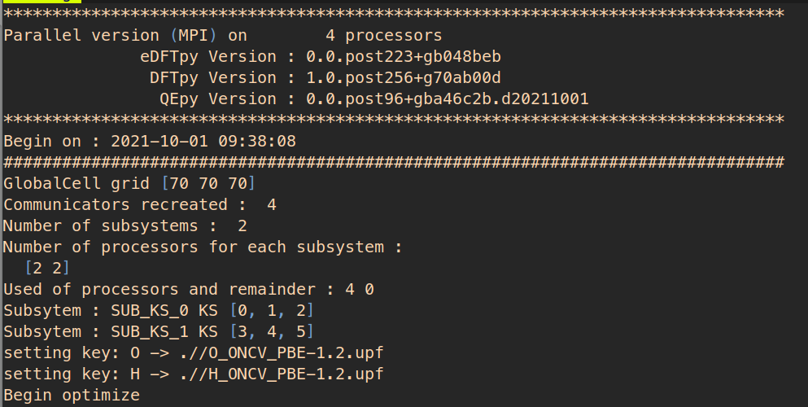
Example of eDFTpy
mpirun -n 4 python -m edftpy input.ini --mpi
input.json
mpirun -n 4 python -m edftpy input.json --mpi
…now go ahead and run it!
./Materials/examples-scf

Slide 11
Structure of eDFTpy
h2o_2.xyz
O_ONCV_PBE-1.2.upf
H_ONCV_PBE-1.2.upf
input.ini
sub_ks_1.in
sub_ks_0.in
edftpy_running.json
edftpy_gsystem.xyz
sub_ks_1.xyz
sub_ks_0.xyz
sub_ks_0.out
sub_ks_1.out
total.xsf
sub_ks_1.tmp
sub_ks_0.xsf
sub_ks_0.tmp
Structure file
Pseudopotential files
Input file of eDFTpy
input.ini or input.json
Input files of subsystem driver
QE: prefix.in
Outputs for check
edftpy_running.json
edftpy_gsystem.xyz
Outputs of subsystem driver
prefix.xyz
prefix.out
Temporary files of subsystem driver
prefix.tmp
Some properties files defined in input file
density of global system and subsystem

Slide 12
Advanced features:
CPU Load Balancing
Use gaussians
[SUB_KS_0]
calculator = qe
embed = KE
cell-split = 0.5 0.5 0.5
cell-index = 0:3
grid-ecut = 2400
nprocs = 3
[SUB_KS_1]
calculator = qe
embed = KE XC
cell-split = 0.5 0.5 0.5
cell-index = 3:6
grid-ecut = 2400
nprocs = 2
[SUB_KS_0]
calculator = qe
embed = KE
cell-split = 0.5 0.5 0.5
cell-index = 0:3
grid-ecut = 2400
density-use_gaussians = True
[SUB_KS_1]
calculator = qe
embed = KE XC
cell-split = 0.5 0.5 0.5
cell-index = 3:6
grid-ecut = 2400
input_pro.ini
input_pro.ini
nprocs
density-use_gaussians
The number of processors for the subsystem
If the minimum of all subsystems is 1, it will be used as a multiplier of # processors.
This is to avoid problems of electrons leaking in the core region of surrounding fragments when hard pseudopotentials are employed.
Notes:
section

Slide 13
Let’s do some coding!
Check out the jupyter notebooks on ./Materials/jupyter-scf

Slide 14

Challenge!
./Materials/examples-scf-challenge
Jupyter challenge: Add you own external potential to a specific subsystem
Input file challenge: make an input file for challenge.xyz with optimal load balance

Slide 15
The End…
Questions?
@MikPavanello
@XuechengShao
@alesgeno

